Slide 1

Quick Start With Astro-Data It’s not all Black and White with Pandas
Soheb Mandhai

Slide 2
Disclaimer
This session acts as a reference guide – I’m not a Python wizard by any means, I just have a couple of years of experience with it and am also learning.

Slide 3

Resources – Follow Along
Github Repo: https://github.com/smandhai/Astro-Data-Handling-Tutorials

Slide 4
Downloading Data

Slide 5
Methods to Download Data

Slide 6
File Formats

Slide 7
Common Types
Typical data formats that you will encounter:
CSV (Comma-Separated Value)
TXT (Text File)
Dat (Data File)

Slide 8
FITS

Slide 9
HDF5/H5 FIles

Slide 10
Loading In Data Files

Slide 11
Common Packages to Load in Files
Pure Python
CSV
Numpy
Astropy
H5PY
Pandas

Slide 12
Loading in Big Files
Skip rows (for sampling)
Chunking (Pandas)

Slide 13
Processing Data Files

Slide 14
Common Methods to Process Data FIles
Numpy is your friend

Slide 15
Visualising Data

Slide 16
Matplotlib

Slide 17
Seaborn

Slide 18
PILLOW

Slide 19
Storing Data

Slide 20
Tables

Slide 21
Arrays

Slide 22
Dictionaries

Slide 23
TIPS

Slide 24

Pseudocode
Write out your algorithm in basic English – create a step by step guide of your logic:
Benefits: This lets anyone translate your algorithm to another programming language if needed
For example, Making Tea – The Algorithm:
Acquire Cup, Tea Bag, Milk, Sugar
Go to Kettle
Check Kettle Water
If water is low:
Refill water
Turn kettle on
Wait
Place Tea Bag in cup with Sugar (NOT MILK – I WILL FIND YOU)
While water == not hot:
Wait
If kettle == done:
water= hot
Pour Water into cup
Stir
Add Milk
Drink

Slide 25






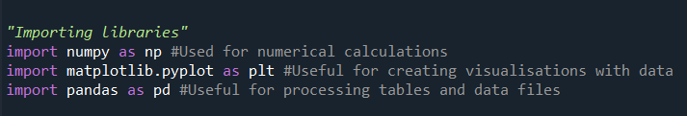
Common Libraries

Slide 26

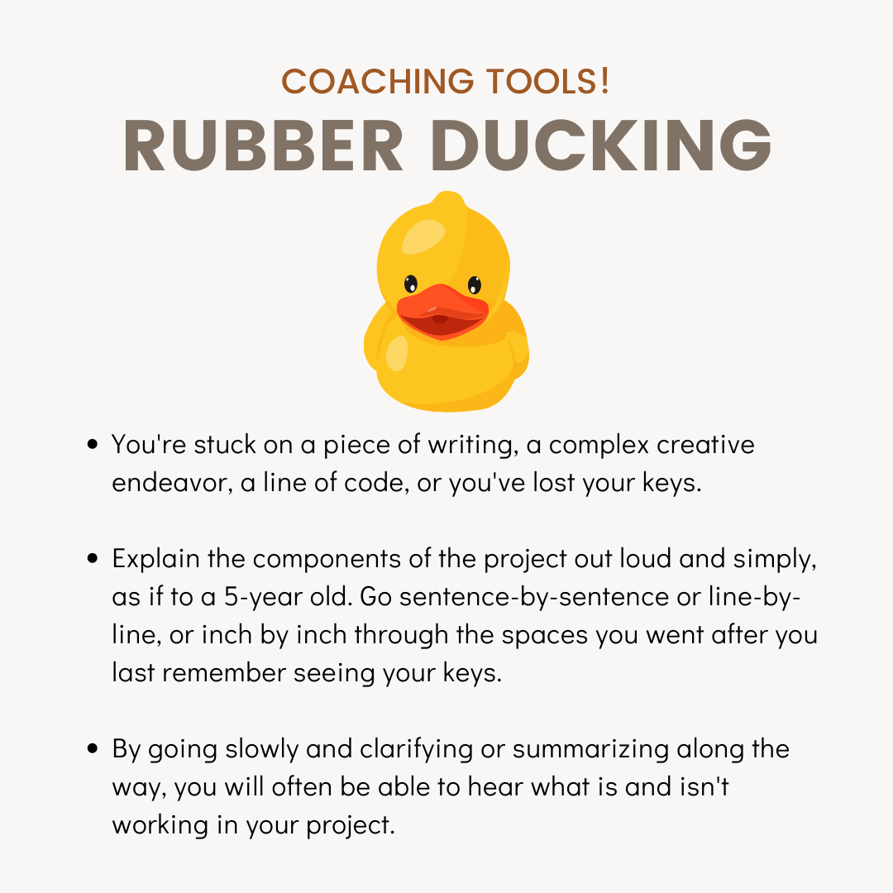
Debugging
Check variable explorer in an IDE to ensure values are what you expect
Narrate your code to a friend or a rubber duck (Rubber Ducking)
Use print statements around offending areas
Follow the traceback
Credit: V & CO Coaching

Slide 27
Additional Resources

Slide 28

Need Help?
StackOverFlow
Your Colleagues
W3Schools
Coding Academy
Many More…

Slide 29

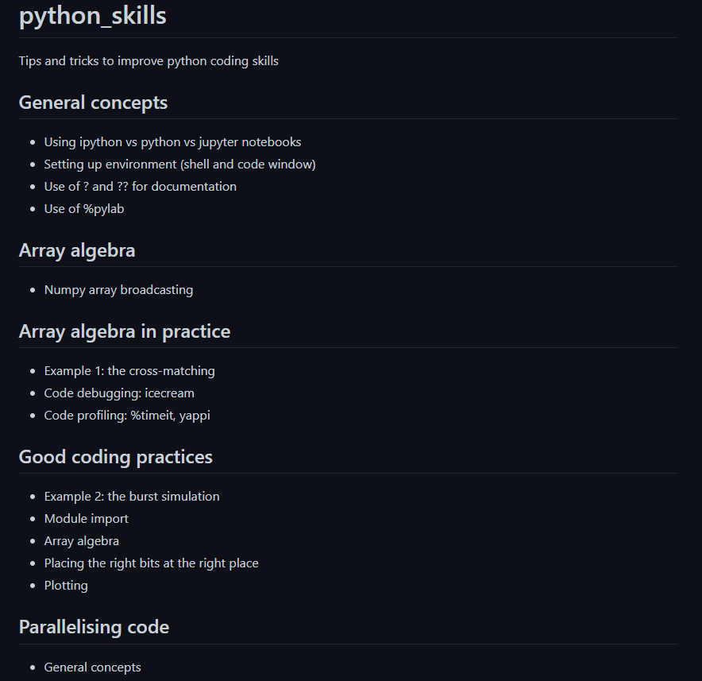
Want to be a Python Jedi?
Check out Rene’s JACS material from previous years - https://github.com/bretonr/python_skills

Slide 30
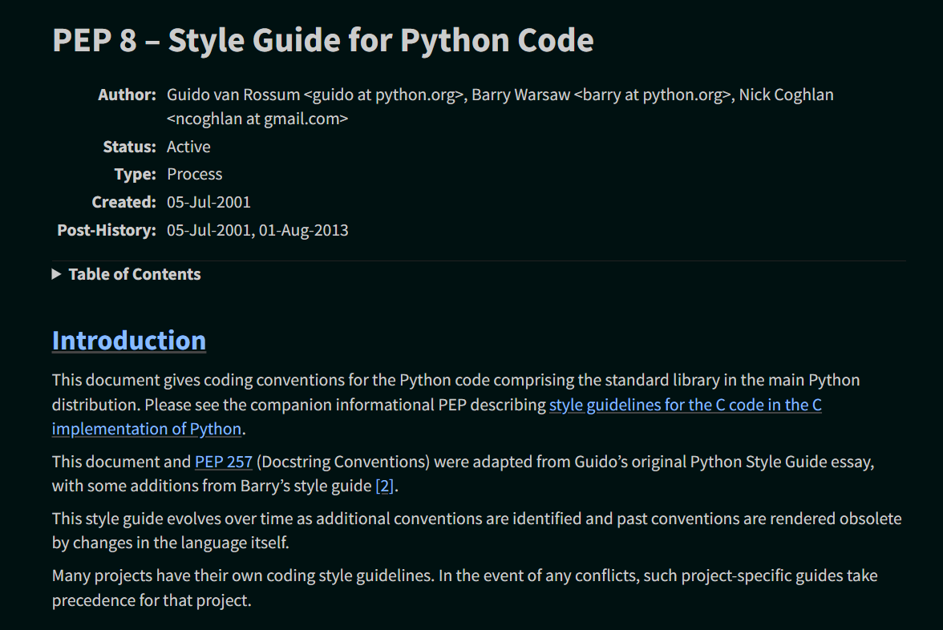
PEP-8 Documentation
Style Guide for Python Code- https://peps.python.org/pep-0008/

Slide 31
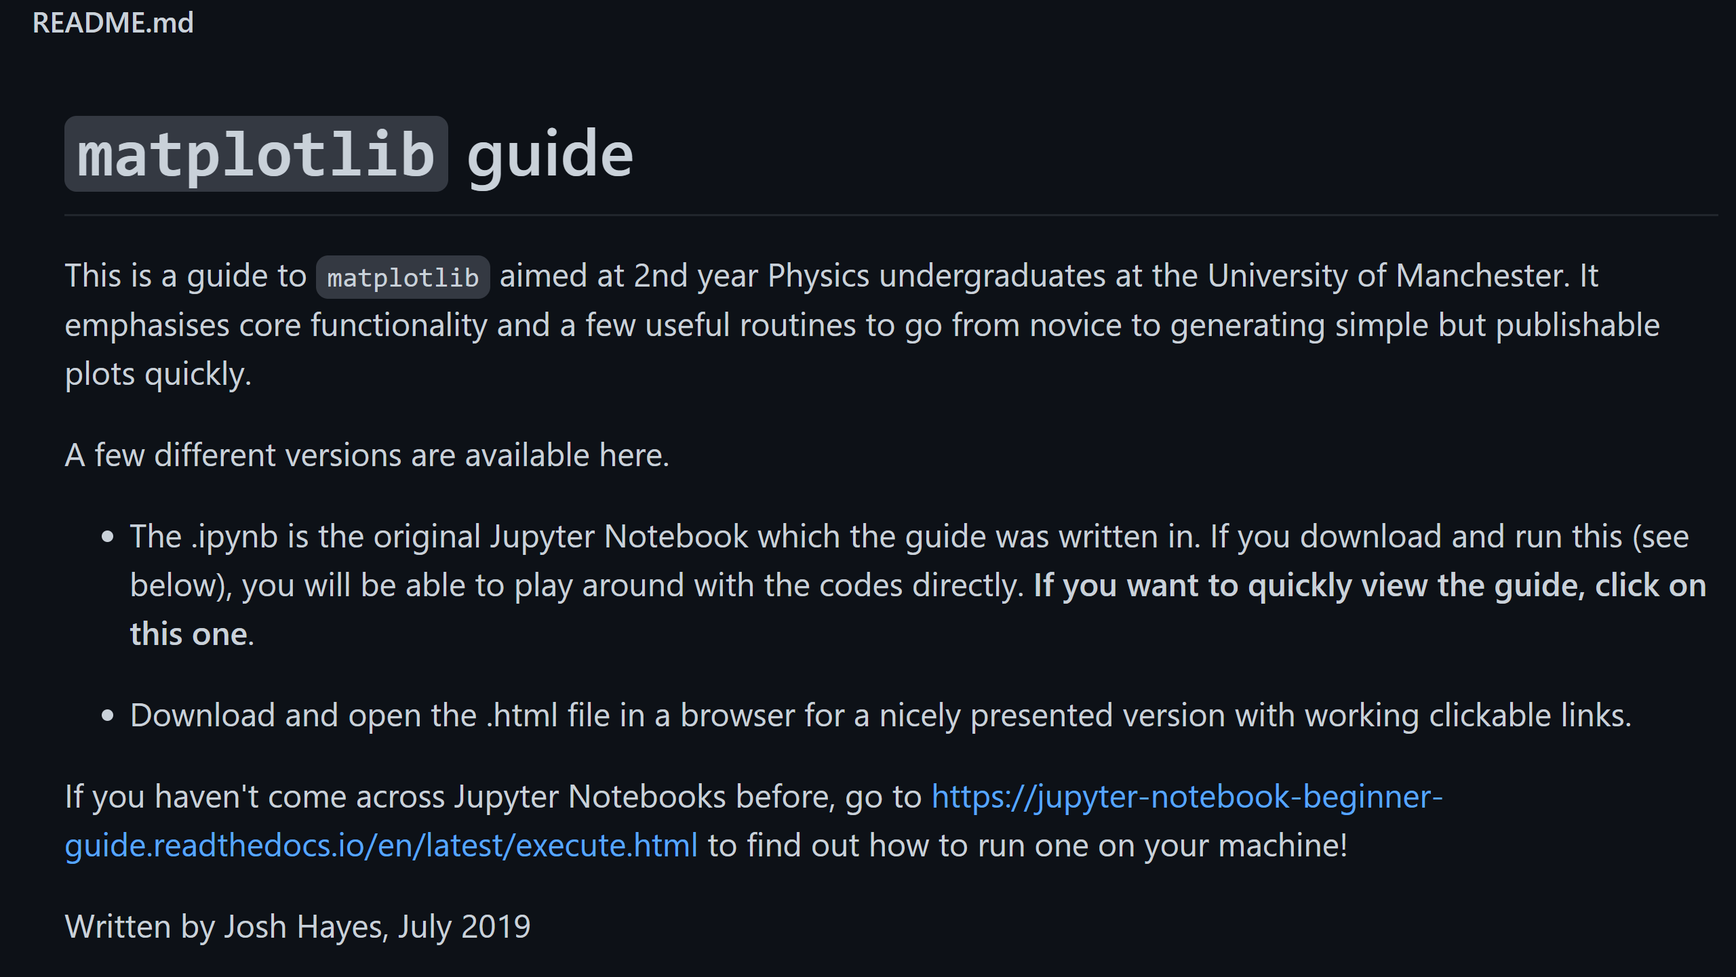
Matplotlib Guide
Want a quick start guide to visualisating data in Python using Matplotlib? Check out Josh Hayes’ repo: https://github.com/joshjchayes/matplotlib_guide

